Slide 1

LAB- 5 Study the concept of VLAN
Computer Networks (CN)
DU #2301CS501
Prof. Maulik D Trivedi
Computer Engineering
maulik.trivedi@darshan.ac.in
+91-9998265805
Disclaimer: The images used in this presentation are sourced solely for educational and nonprofit purposes. The author of this presentation asserts no ownership or copyright claims over them."

Slide 2
✓
Outline
What is VLAN?
Need of VLAN
Advantages of VLANs
Access and trunk interface
Configuration of VLAN
Step to configure VLANs

Slide 3
Broadcast in LANs
A broadcast domain is a set of devices that can receive broadcast messages from each other.
Broadcast messages are packets that are sent to all devices on the same network, such as ARP requests or DHCP offers.
They can also consume bandwidth and cause network congestion if there are too many devices or too much traffic on the same network.
2 different networks LANs switch forwards' traffic.

Slide 4
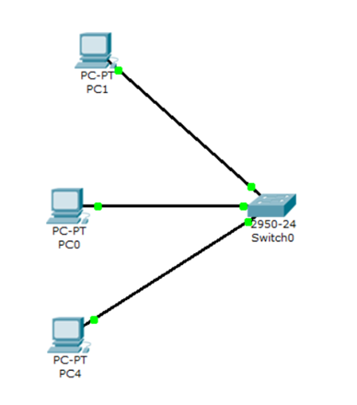
Broadcast in LANs
Two different LANs
LAN 1
LAN 2

Slide 5
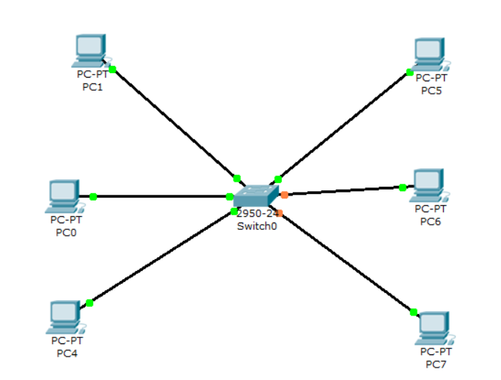
Broadcast in LANs
Design a two LANs which has one switch and three PCs. LAN 1 PCs can’t communicate with LAN 2
If you connect the system then LAN 1 PC can communicate with other
So how to separate them logically.
What is solution?
LAN 2
LAN1
Solution is “VLAN”

Slide 6







VLANs
192.168.10.3
192.168.10.5
VLAN 1
VLAN 3
192.168.10.2
192.168.10.7
VLAN 2
192.168.10.4
192.168.10.6

Slide 7
VLAN
Virtual LANs or VLANs are usually configured on switches by placing some devices into one broadcast domain and some devices into some other broadcast domain.
VLANs keep traffic from different networks separated when traversing shared links and devices within a topology.
Each VLANs acts as a subgroup of the switch ports in an Ethernet LAN.
VLAN 2

Slide 8
VLAN Example
VLANs per port view

Slide 9
Access and Trunk Interfaces
Ethernet interfaces can be configured in two ways:
Access ports
Trunk ports

Slide 10
An access port can have only one VLAN configured on the interface; it can carry traffic for only one VLAN.

Slide 11

An access port can have only one VLAN configured on the interface; it can carry traffic for only one VLAN.
Access Port
Access Port
Access Port
Access Port
Access Port
Access Port

Slide 12
A trunk port can have two or more VLANs configured on the interface; it can carry traffic for several VLANs simultaneously.

Slide 13
A trunk port can have two or more VLANs configured on the interface; it can carry traffic for several VLANs simultaneously.
Access Port
Access Port
Trunk Port
Trunk Port
Access Port
Access Port
Access Port
Access Port

Slide 14
VLANs on multiple switches
VLANs spanned on multiple switches with Trunking

Slide 15
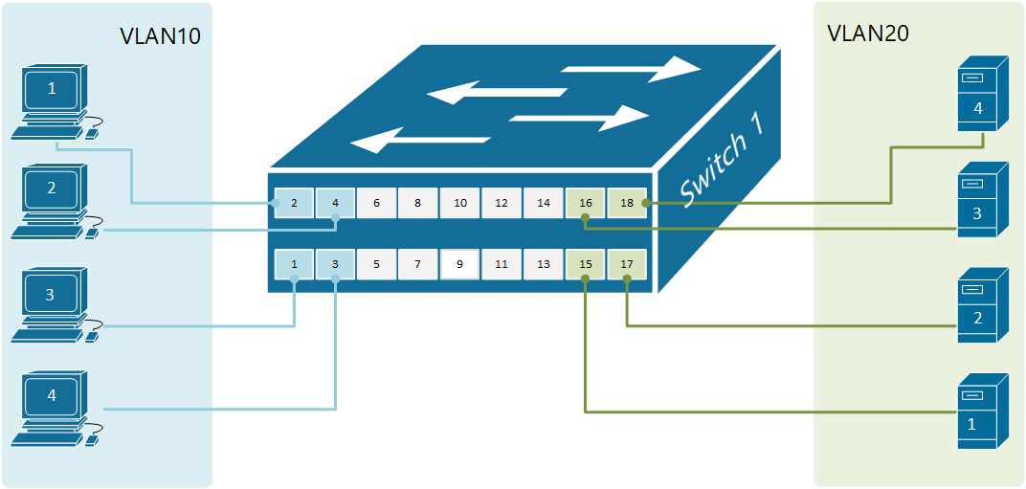
Configure VLAN
Example of a switch with two VLANs

Slide 16
Steps to create VLANs
In the CLI tab of the switch type conf t and press enter
Type vlan 10 on the prompt and press enter
Type name A BLOCK on the prompt and press enter
Enter exit on the prompt and press enter
Type vlan 20 on the prompt and press enter
Type name C BLOCK on the prompt and press enter
Enter end on the prompt and press enter
Type show vlan brief and press enter
Type conf t and press enter
Type interface range fa0/1 – 4
Type switchport access vlan 10
Type switchport mode access
Type exit

Slide 17
Steps to create VLANs
Type exit and press enter
Type interface range fa0/15-18
Type switchport access vlan 20
Type switchport mode access
Type end and press enter
Type show vlan brief and press enter

Slide 18
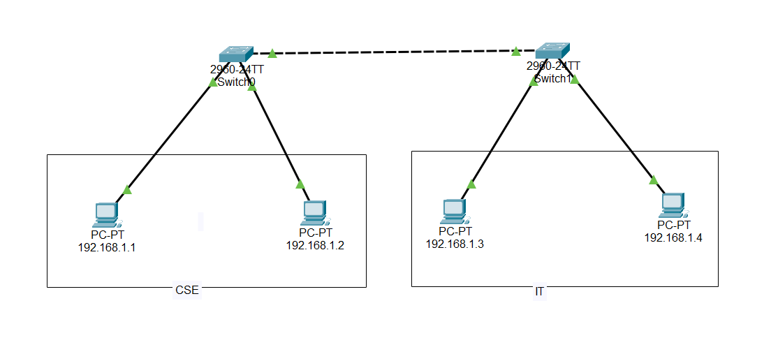
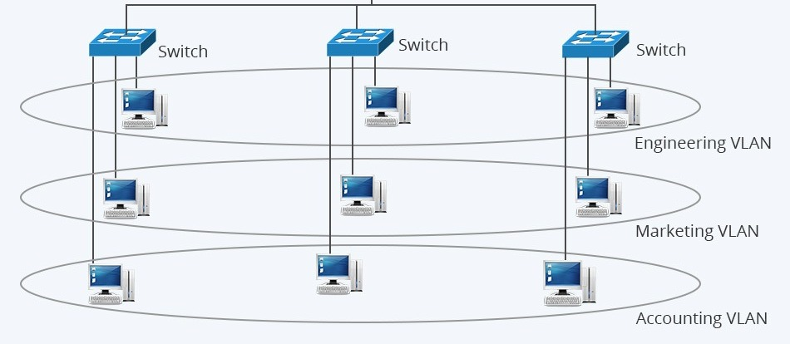
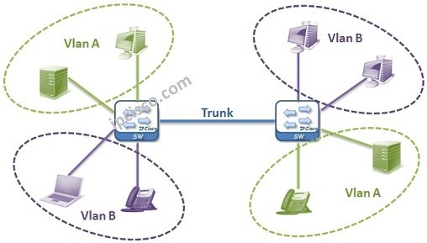
Example VLANs

Slide 19
Thank you

